Slide 1
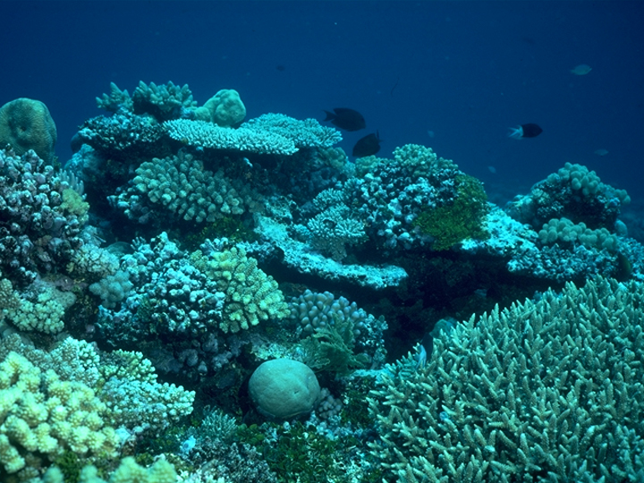



Caring for
The Great Barrier Reef
Marine Park &
World Heritage Area
Dr Laurence McCook,
Great Barrier Reef Marine Park Authority,
Pew Fellow in Marine Conservation.
Pew Fellows Program
in Marine Conservation
Notes:
1

Slide 2
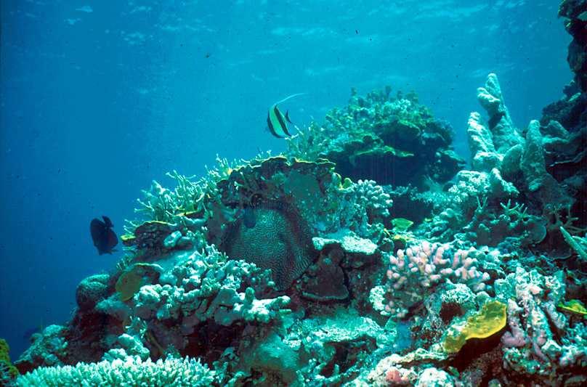
Introduction
GBR place of extraordinary environmental, social & economic value.
Beauty.

Slide 3
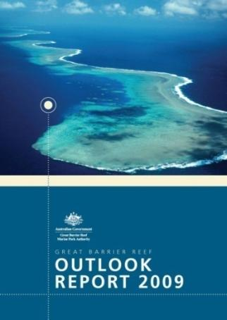
Adaptive Management & assessing effectiveness
Adapt & Revise
Actions
& Monitoring
Conceptualize
Plan actions &
Monitoring
Analyze & Review
effectiveness
Implement Actions
& Monitoring
Review of zoning
Outlook Report
Strategic Assessment

Slide 4
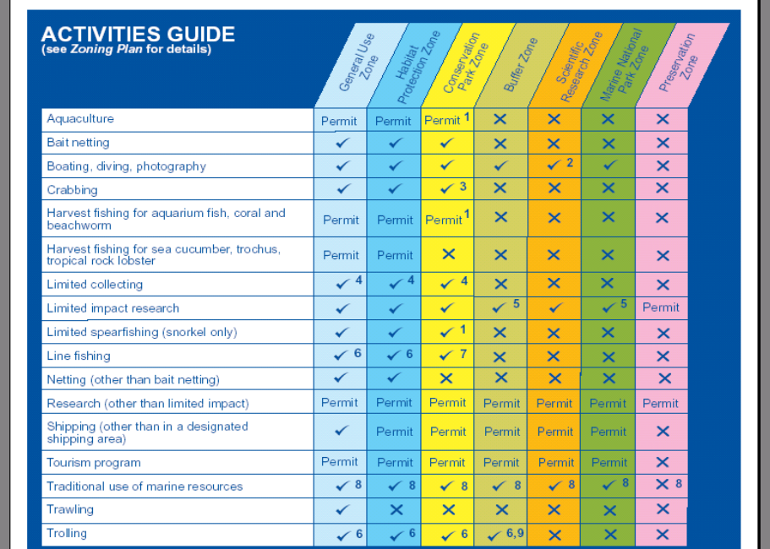
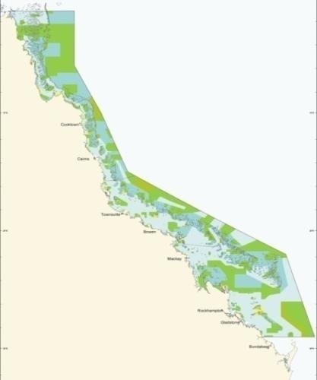
Great Barrier Reef Zoning
(a global standard for marine conservation)
Key management tool
(But only 1 part of integrated portfolio of strategies)
In different zones, activities are:
  allowed ‘as of right’
  require a permit
  Prohibited
Best practice design & implementation;
Rigorous & accountable principles of conservation science
Large area
Notes:
4

Slide 5
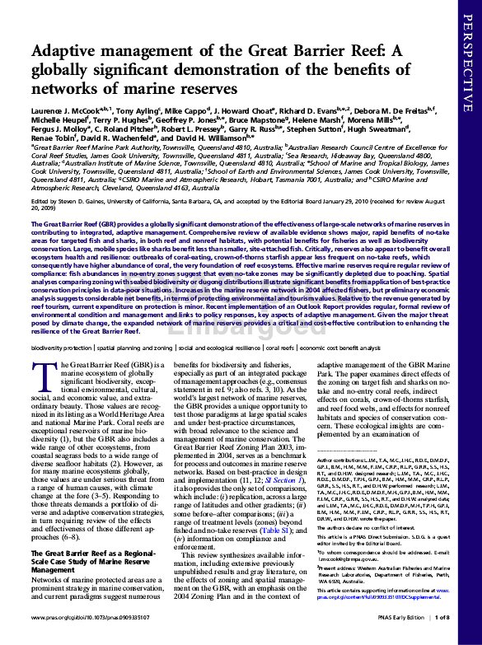
5 years on: review & synthesis of outcomes
21 leading scientists from Great Barrier Reef;
Fish
Sharks
Corals & Starfish
Non-reef habitats
Seabed habitats
Dugong
Turtles
Compliance
Social surveys
Economics

Slide 6
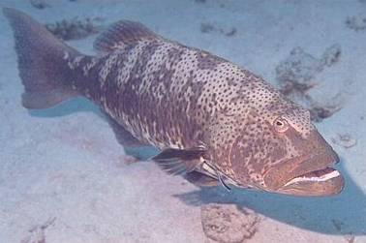
Outcomes:
More, bigger fish in protected areas…
Clear, widespread evidence for long-term benefits;
Requires good compliance & enforcement;
Possible widespread depletion, by 1984 (inshore)
Notes:
6

Slide 7
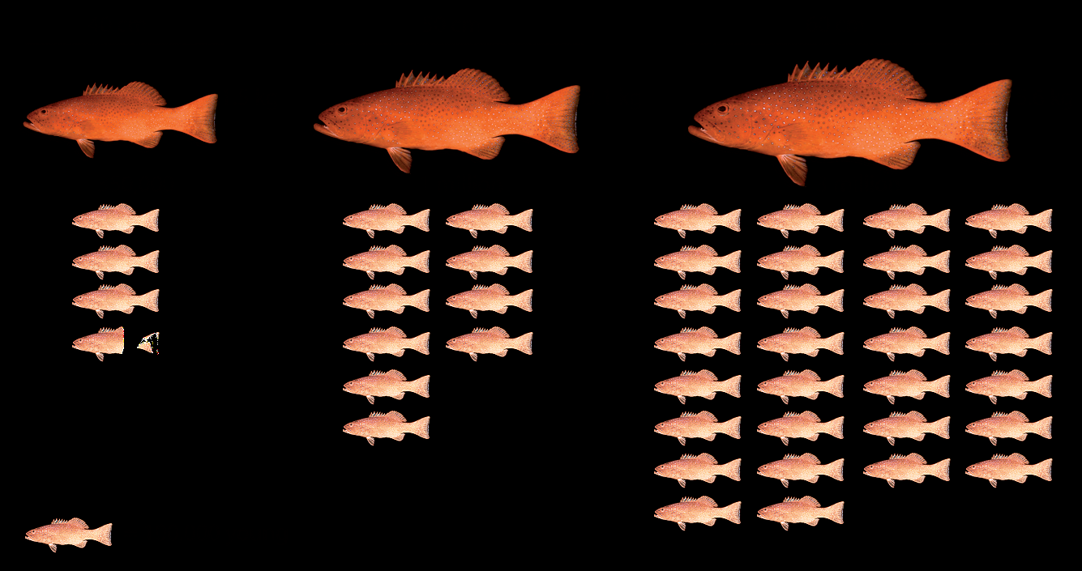
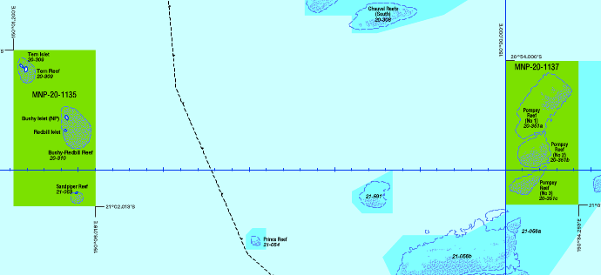

Ecosystem-wide benefits for fish: the network…
Benefits to other reserves;
Most larvae on reserve & fished reefs from protected reserve reefs;
Good for fisheries & entire ecosystem…

Slide 8

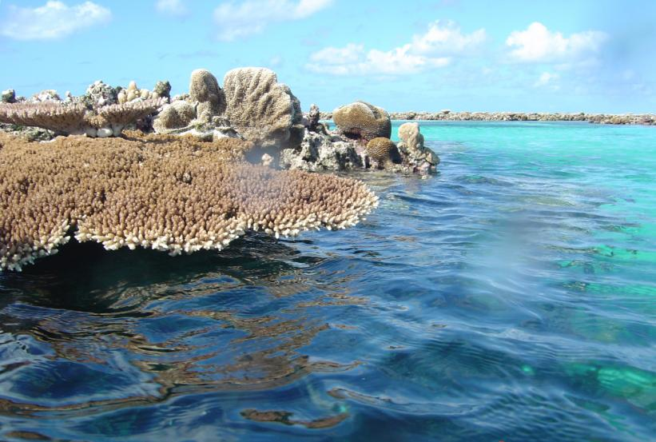
Indirect effects:
Crown-of-thorns starfish reduced, & coral increased…
Fewer outbreaks of starfish;
More coral during outbreak times
Notes:
8

Slide 9
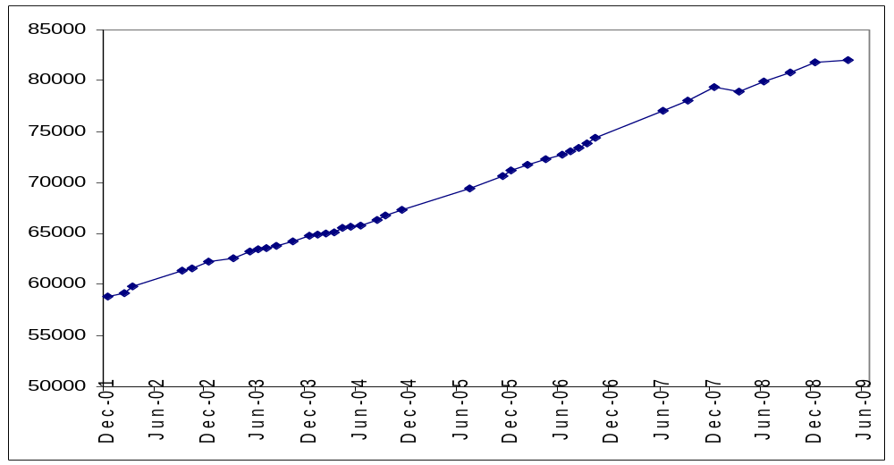
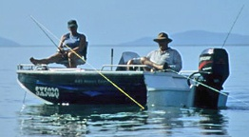
Social information:
Failure of collapse in recreational fishery
2004
Zoning
Plan
Recreational vessel registrations:
Notes:
9

Slide 10
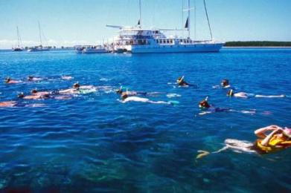
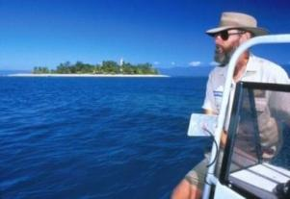
Economics of reef management
(assumptions vs evidence)
Recreational
Use
6
2004
Zoning
Plan
5
Commercial
Fishing
4
$ Billions
Tourism
3
2
1
0
Cost
Revenue
Cost
Revenue
Cost
Revenue
2004-05
2005-06
2006-07
Income:
Reef contributes $5.5 billion/yr & ~53,800 full time jobs; increasing
Costs:
Great Barrier Reef Marine Park Authority: < 0.7 % of revenue…
Enforcement <0.3%
Structural Adjustment - $211 million: <4% of 1 yr revenue…
Notes:
10

Slide 11

Outlook: Risks & challenges
A stock take of where we have come from, where we are at & where we are going
A synthesis of science & other relevant information to the Great Barrier Reef
Assesses management effectiveness
www.gbrmpa.gov.au/outlook-for-the-reef/great-barrier-reef-outlook-report

Slide 12
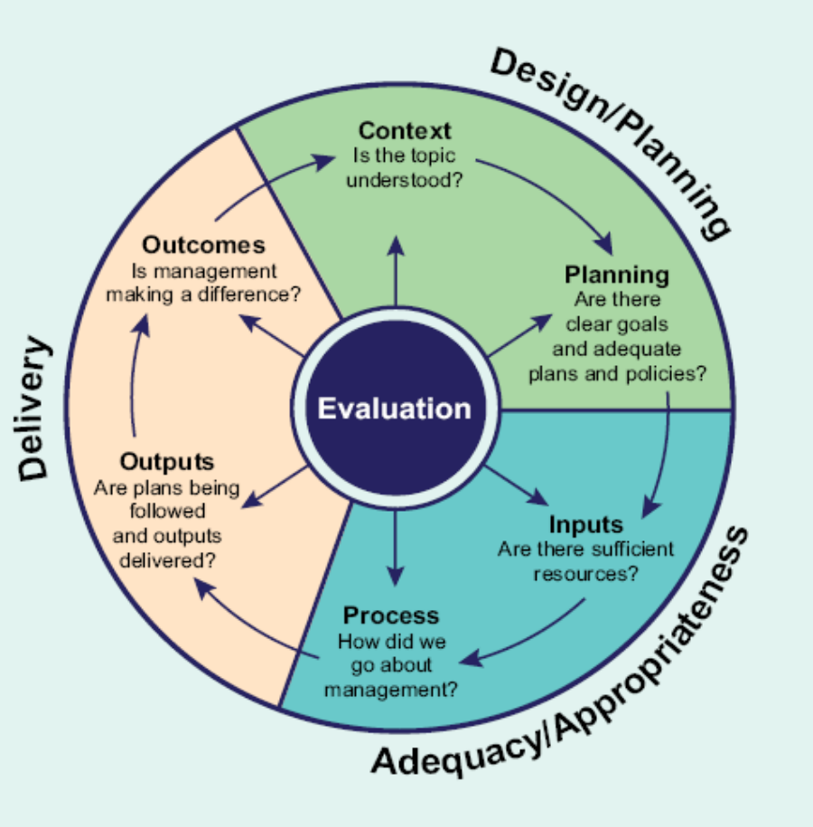
Existing protection & management
All management, not just by GBRMPA
Independent assessment
(by 2 internationally recognised experts)
High level review of
12 key management topics
Input from Queensland & Australian Government agencies
Adapted from Hockings et al. 2006, IUCN WCPA
Notes:
One of the important components of the Outlook Report is the assessment of protection and management. It is one of the eight assessments required by the Great Barrier Reef Marine Park Act.
The assessment covers, at a high level, all measures to protect and manage the Great Barrier Reef ecosystem, not just management activities undertaken by the GBRMPA.
Unlike the other assessments, this one was undertaken independently by Marc Hockings and Brian Gilligan who are very experienced in protected area management, public policy and governance. They examined 12 management topics, including areas such as climate change, marine tourism, fishing, water quality and biodiversity protection.
They used the six management elements developed by the IUCN World Commission on Protected Areas. In this framework, the management arrangements are assessed from the perspectives of their design, their adequacy of implementation, and their delivery of outcomes. This approach is IUCN's standard and used in over 100 countries covering 7 000 protected areas.
Significant background information was collected through two workshops involving representatives across Australian and Queensland Government agencies.
The external assessors synthesized this information and provided an 'effectiveness' statement against each of the six elements for 12 management topics.
Their report was accepted by the Chairman of the GBRMPA, and it forms the basis of the ‘assessment of measures to protect and manage’ the Great Barrier Reef (Chapter 6). The full report can be found on the online information system.

Slide 13
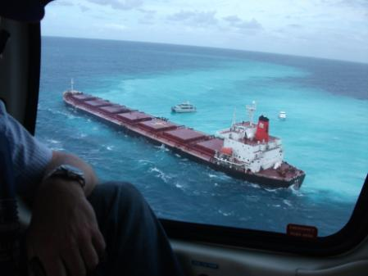
Management topics
biodiversity protection
heritage
water quality
climate change
coastal development
commercial marine tourism
defence
fishing (commercial & recreational)
ports & shipping
recreation (not including fishing)
scientific research
traditional (indigenous) use of marine resources
Notes:
These were the management topics assessed. Some of them directly relate to the values of the Great Barrier Reef (shown in dark blue), some are external factors that influence the Reef (green) and the remaining 7 are direct uses (light blue).
Importantly, the assessment of climate change is only in relation to management measures undertaken specifically to protect and manage the Great Barrier Reef and did not consider national and global initiatives.
All the input from the government agencies for each of these topics was considered by the expert assessors in relation to the 6 assessment criteria.

Slide 14
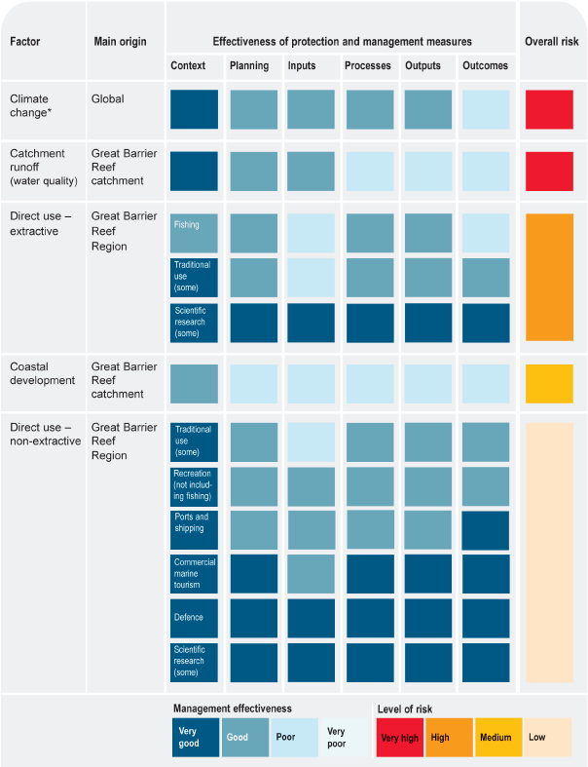
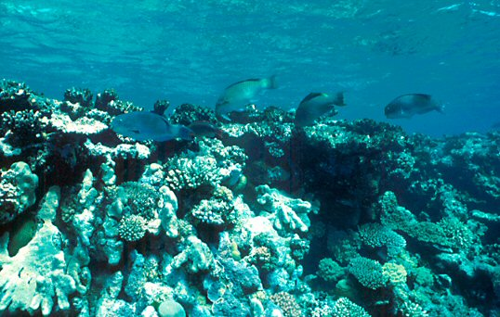
Overall Outlook 2009
"The outlook for the Great Barrier Reef ecosystem is at a crossroad, and it is decisions made in the next few years that are likely to determine its long-term future"
Notes:
As you can read, the overall conclusion of the Outlook Report is that the outlook for the Great Barrier Reef ecosystem is at a crossroad.
While the Great Barrier Reef is recognised as one of the world's best managed reefs and is likely to survive better under the pressure of accumulating risks than most reef ecosystems, the Outlook Report identifies that the current long-term outlook for the Great Barrier Reef is poor.
Unavoidably future predictions of climate change dominate most aspects of the Great Barrier Reef's outlook over the next few decades. Decisions made in the next several years are likely to determine its long-term future. The future outlook for the Great Barrier Reef will depend to a large degree, on the extent to which climate change is addressed worldwide and on the resilience of the ecosystem in the immediate future.
In terms of the formal assessment of the 'long-term outlook for the Great Barrier Reef ecosystem', the Outlook Report concludes that the Assessment Grade is 'POOR'.

Slide 15
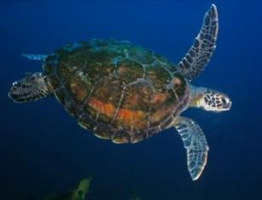
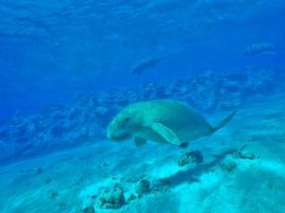
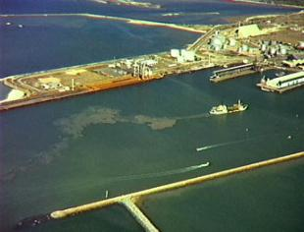
Emerging issues –
Outlook 2009 → Outlook 2014
Declines: corals; seagrasses; dugongs; turtles;
Accumulation of impacts:
Need for coordinated, integrated management across issues, time, space... (carrying capacity / upper limits)
Unprecedented growth in coastal development – ports, shipping, urban & mining/industrial
Pressures on inshore biodiversity
World Heritage Committee Concerns re: approval of port facilities within GBR World Heritage Area
Heritage
Step up in management of impacts for long-term, large scale...

Slide 16
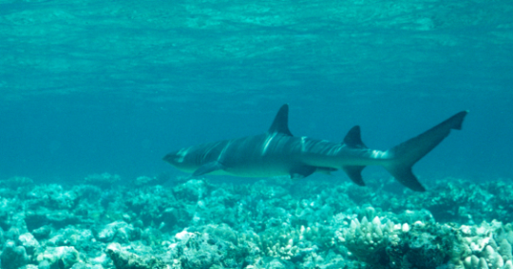
GBR Strategic Assessment
Provide overarching assessment of effectiveness of management arrangements to protect Great Barrier Reef values
GBRMPA (marine) & State (Queensland) components
to examine cumulative impacts on values
– multiple pressures from multiple activities
– rather than project by project assessments
Ensure that management tools used are most effectively tackling the range
of pressures on values
Strongly linked to 5 year
Outlook Report cycle.
Notes:
"Part of the Government's response to the World Heritage Commission's concerns.
Avoid ANY comment on WHC recommendations. Refer to RR / online.
Reserve slides at end with more detail. EPBC

Slide 17
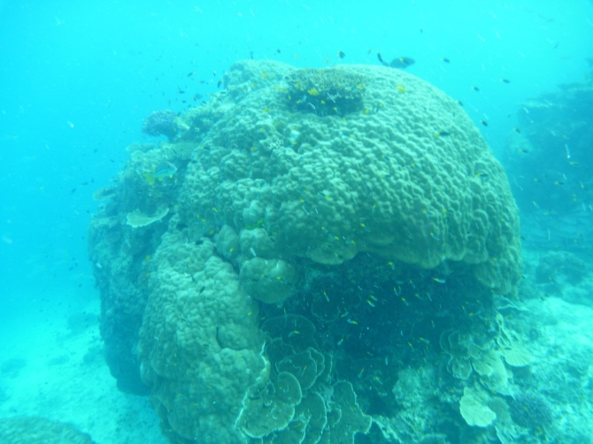
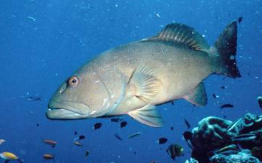
Summary: Adaptive management of the
Great Barrier Reef
5 yearly Outlook Report;
Strategic Assessment of management effectiveness;
Reef has declined;
Need a step-up in management
to maintain values.
Reserve network:
Significant ecosystem benefits;
Probable benefits to tourism & fisheries …
Highly Cost-effective…
1 part of package of
complementary management
→ www.gbrmpa.gov.au
Notes:
Step-up in management: and we are on it- aware of issues (cumulative impacts) through Outlook 09 and other processes, and Strategic Assessment provides an ideal framework for strategic planning and implementation of necessary actions.
NO mention of WHC Recommendations etc.

